Slide 1
Orchestra: Intrusion Detection Using Parallel Execution and Monitoring of Program Variants in User-Space
Babak Salamat, Todd Jackson, Andreas Gal, Michael Franz
Department of Computer Science
School of Information and Computer Sciences
University of California, Irvine
March 2009

Slide 2
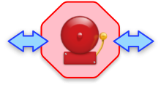
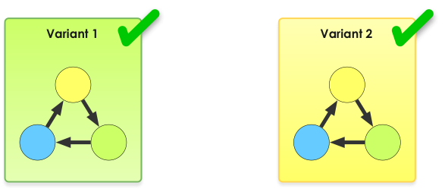
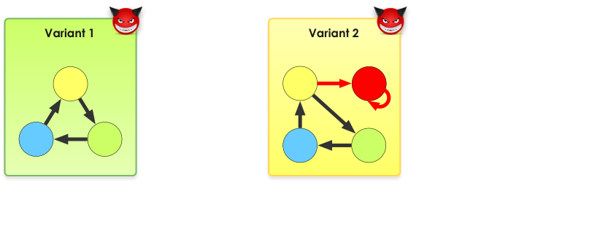
Multi-Variant Execution

Slide 3
Detection Requirements
Lock-step execution
Feed all variants with identical input
Attack vectors have different effects on different variants

Slide 4
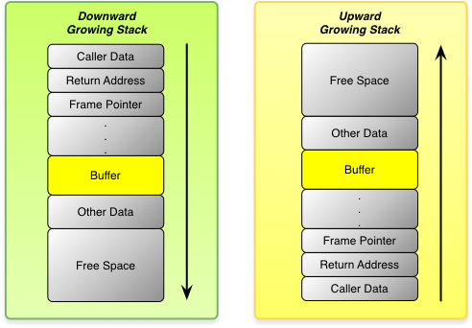


Reverse Stack Growth Direction
Stack objects are located in opposite positions

Slide 5
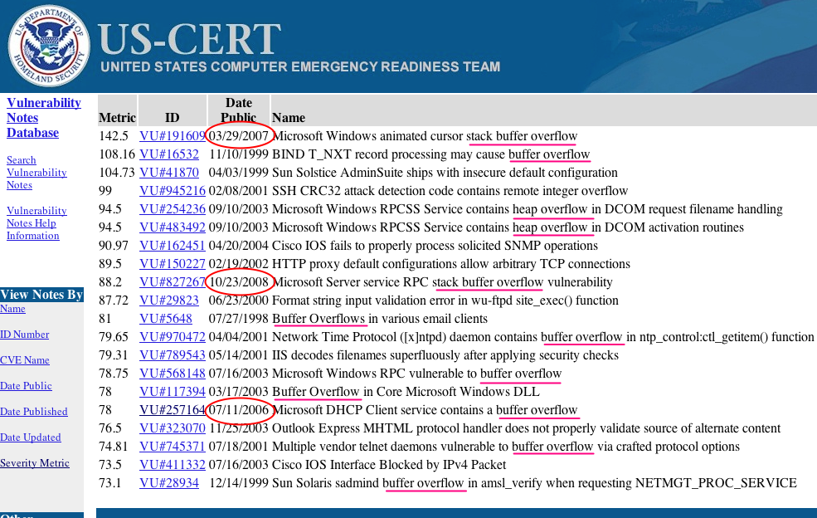
Top 20 Vulnerabilities of All Time

Slide 6
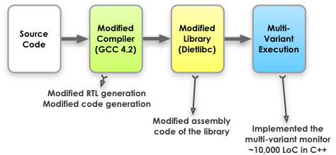
From Source to Execution

Slide 7
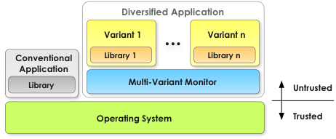
Orchestra Architecture
The monitor is a user-space application

Slide 8
Granularity of Monitoring
Granularity of monitoring and Synchronization
  Ideally after each instruction
  Not always possible
  Performance issues
Synchronize and monitor at system calls
  No harm is done without calling any system call
  All instances must invoke the same syscall with equivalent arguments

Slide 9
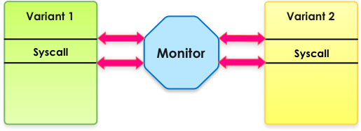
System Call Monitoring
Debugging facility of Linux (ptrace) is used to build the monitor
The monitor is notified twice per system call

Slide 10
System Call Monitoring (cont.)
Equivalency is checked at the beginning of a system call
  The system calls must be the same
  Arguments must be equivalent
    Pointers (buffers) have the same content
    Values are identical
Results of the system call are written back to the variants at the end of the system call if needed

Slide 11
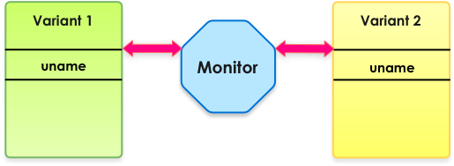
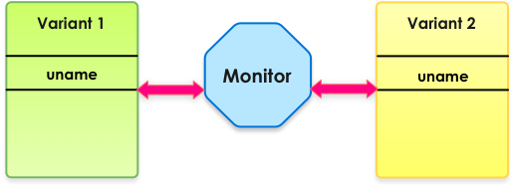
System Call Execution
Non-state changing system call that produce immutable results are executed by all

Slide 12
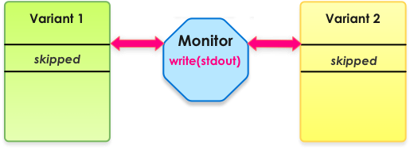
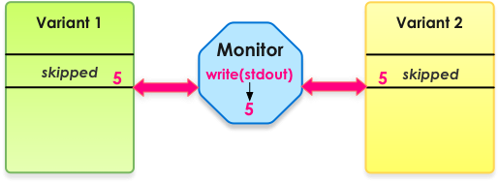
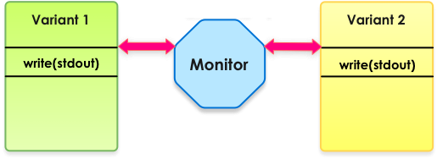
System Call Execution (cont.)
State changing system calls are executed by the monitor

Slide 13
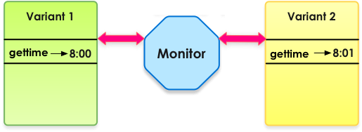
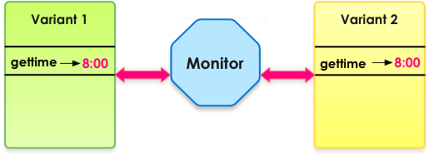
System Call Execution (cont.)
Non-state changing system call that produce non-immutable results are executed by all, results are copied from the first variant to all

Slide 14
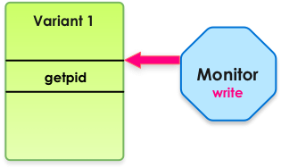
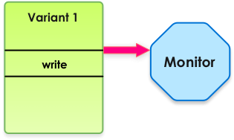
Skipping a System Call
A system call must be executed when OS is notified
Replace the system call by a non-state changing one to skip it

Slide 15
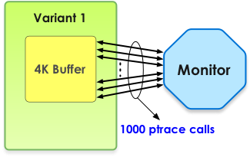
Data Transfer
ptrace transfers only 4 bytes at a time
  very slow in transferring large buffers

Slide 16
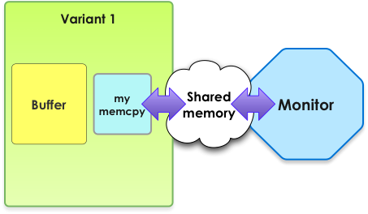
Data Transfer (cont.)
We tried using named pipes, but they cannot transfer more than 4K bytes at a time
Shared memory is fast and can transfer mega bytes

Slide 17
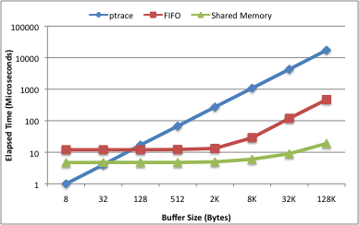
Data Transfer Performance
Shared memory is about 1000 times faster than ptrace and 20 times faster than FIFO in transferring a 128K buffer

Slide 18
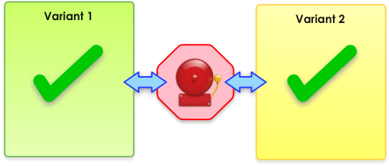
Removing False Positives
False positives are the major practical issue in using multi-variant execution

Slide 19
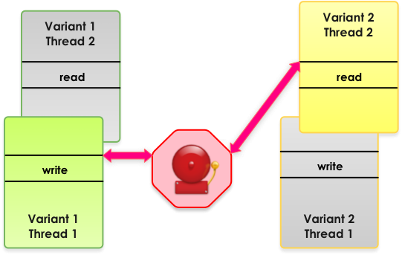
Multi-Threaded Variants
Different scheduling of multi-threaded or multi-process applications can cause false positives

Slide 20
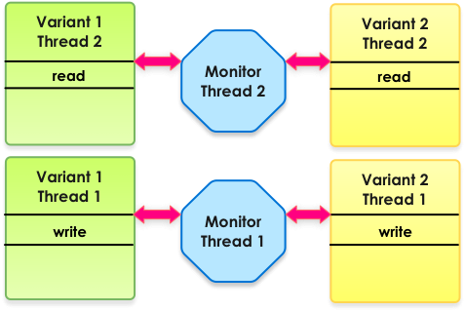
Monitoring multi-threaded variants
Corresponding threads/processes must be synchronized to each other

Slide 21
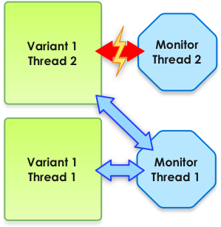
Deficiency of ptrace
Only one monitor can attach to a process
If the main monitor detaches from thread 2, thread 2 will continue execution
  Many system calls may be executed before the second monitor attaches

Slide 22
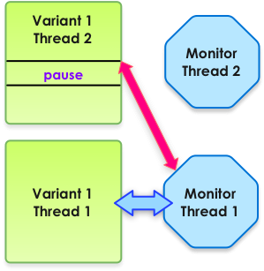
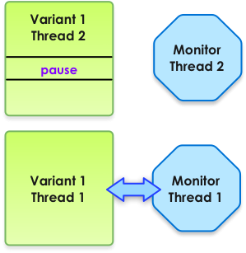
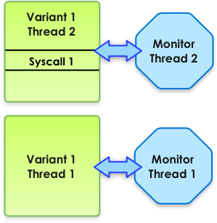
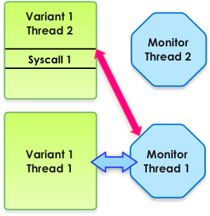
Solution to The ptrace Problem
The main monitor continues monitoring new threads/processes until the first system call invocation
The first system call is replaced by “pause”
The main monitor detaches
The second monitor attaches without missing any system call

Slide 23
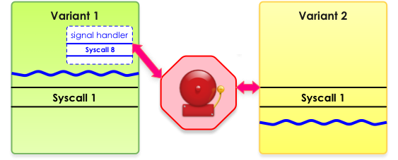
Asynchronous Signals
Signal handlers can cause different sequences of system calls to be executed by the variants

Slide 24
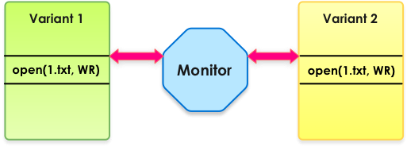
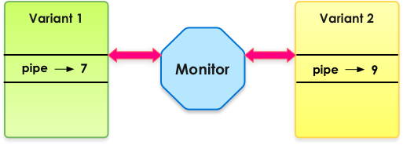
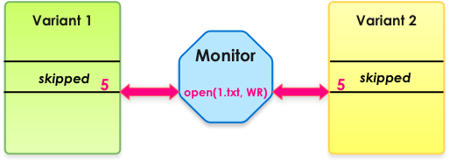
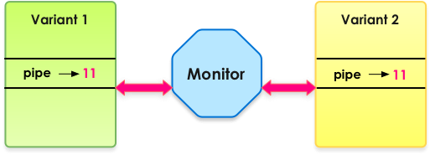
File Descriptors
The same file descriptor is always reported to all variants when they invoke system calls that return a file descriptor

Slide 25
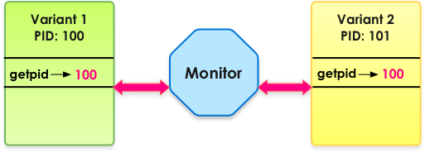
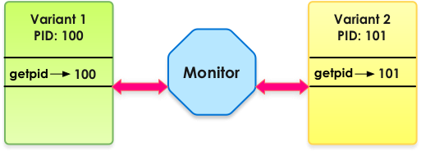
Process ID
Monitor reports the process ID of the first variant to all
The PID of the first variant’s child process is reported as the result of fork or clone to all the variants

Slide 26
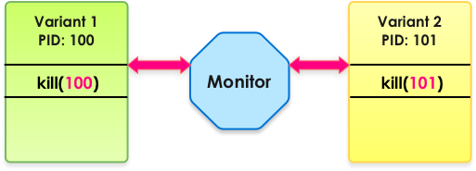
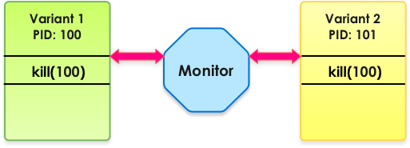
Process IDs in Arguments
When variants need to run a system call that receives a PID, appropriate PID is restored before the execution of the system call

Slide 27
Time and Random Numbers
System calls that read time (e.g., gettimeofday) are executed by one variant and the result is copied to all
By providing identical time and other system information to all variants, they likely use the same seed to generate random numbers
The monitor reads /dev/urandom and copies the result to all variants
Reading CPU time stamp counters (RDTSC) may still cause false positives

Slide 28
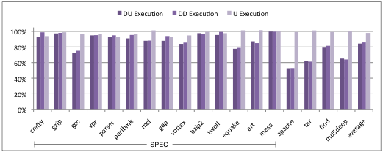
Performance

Slide 29
Summary
Multi-variant execution is an effective technique in detecting and disrupting attacks
A reverse stack executable can prevent stack-based buffer overflow vulnerabilities in a multi-variant environment
The introduced techniques remove most sources of false positives in multi-variant execution
Running two parallel variants have about 15% overhead on a multi-core processor

Slide 30
Thank you
Questions?

Slide 31
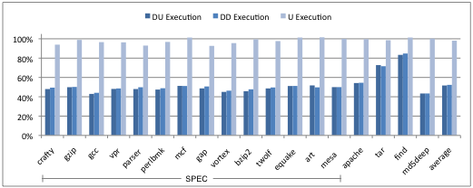
Performance on a Loaded System

Slide 32
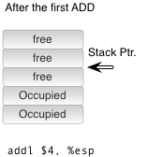
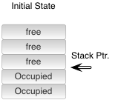
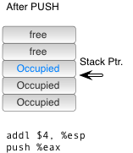
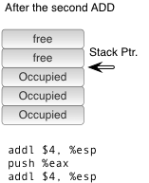

Reversing the Stack Growth
Most hardware platforms support one stack growth direction
Stack manipulation instructions should be augmented

Slide 33

CALL and RET instructions
SP adjustment cannot be performed after a CALL or RET
Adjust SP at the prologue of functions for CALLs
Adjust SP after CALLs for RETs

Slide 34
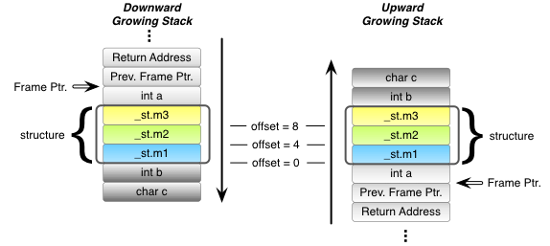
Arrays and Structures
Order of bytes in large units of data must be the same for all stack growth directions

Slide 35
Callee Popped Arguments
Some functions remove their own arguments from the stack (e.g., __stdcall)
“RET n” in x86 reads return address then increments SP by n
GCC considers ECX as clobbered after a function call. Using ECX does not need store and restore
Normal Stack | Reverse Stack
ret $8 | movl -4(%esp), %ecx leal -12(%esp), %esp jmp *%ecx

Slide 36
Effects of Compiler Optimization
Many of the SP adjustment instructions are removed
Non-optimized | Optimized
addl $8,%esp movl -12(%ebp),%eax movl %eax,-4(%esp) leal 4(%esp),%esp call strlen leal -4(%esp),%esp movl %eax,-8(%esp) movl $.LC0,-4(%esp) leal 4(%esp),%esp call printf leal -4(%esp),%esp | addl $12,%esp movl -12(%ebp),%eax movl %eax,-8(%esp) call strlen movl $.LC0,-8(%esp) movl %eax,-12(%esp) call printf subl $4,%esp

Slide 37
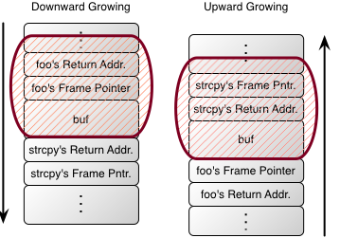

Attacking the Reverse Stack

Slide 38
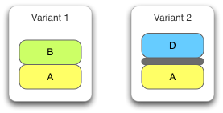
Heap layout randomization
Locations of heap blocks are randomized

Slide 39
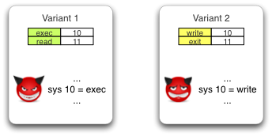
System call number randomization
System calls are not identical in all variants

Slide 40
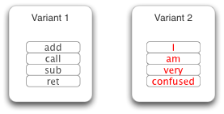
Instruction Set Randomization
Instructions have different meanings in different variants

Slide 41
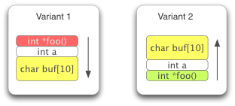
Reverse Stack Growth Direction
Stack objects are located in opposite positions

